Slide 1

Predicting Nitrogen Dioxide (NO₂) Concentrations in Houston Using Machine Learning and Time-Series Analysis (2018–2024)
Student Name: Revanth Kumar Sagala
Student ID: 23076874
Supervisor Name: Vandana Das
GitHub link:

Slide 2

Research question
How effectively can machine learning and time-series models predict daily Nitrogen Dioxide (NO₂) concentrations in Houston, and which meteorological and temporal factors contribute most to these variations?

Slide 3
Dataset
1. EPA Air Quality Data (NO₂):
Source: U.S. EPA Air Quality System (AQS)
Link: https://aqs.epa.gov/aqsweb/airdata/download_files.html#Daily
Data Period: 2018–2024
Variables: State, County, City, Date, NO₂ concentration (Arithmetic Mean), AQI, Latitude, Longitude
2. Open-Meteo Weather Data:
Source: Open-Meteo API
Data Period: 2018–2024
Variables: Daily Temperature (Max/Min), Precipitation, Wind Speed, Humidity, Air Pressure

Slide 4

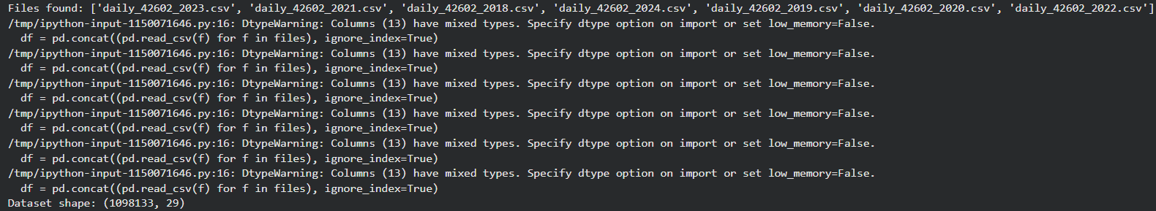
Combining the Datasets and Fetching the weather data

Slide 5
Data Preprocessing and cleaning
Filtered for Houston to maintain consistency
Converted dates, standardized columns
Merged with daily weather data using timestamps

Slide 6
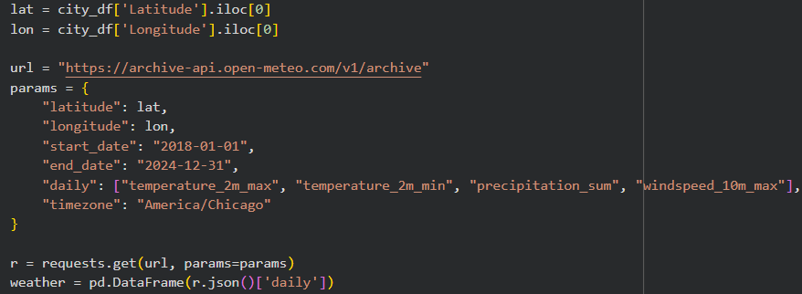

Slide 7
Exploratory data analysis (EDA)
Trend: Clear seasonal variation in NO₂
01
Highest NO₂: Winter months
02
Lowest NO₂: Summer months
03
Created visualizations: monthly trend, seasonal boxplot, and rolling averages
04

Slide 8
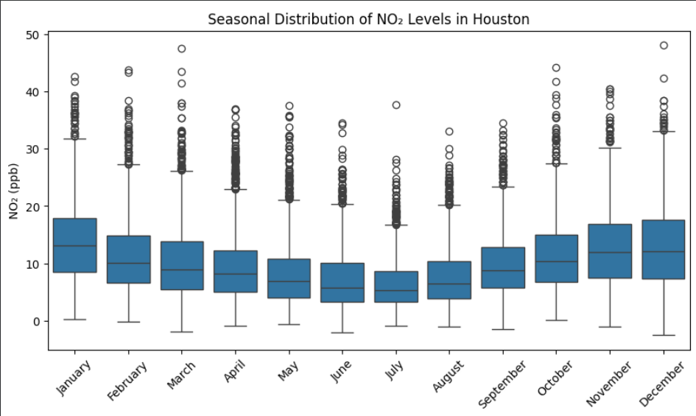
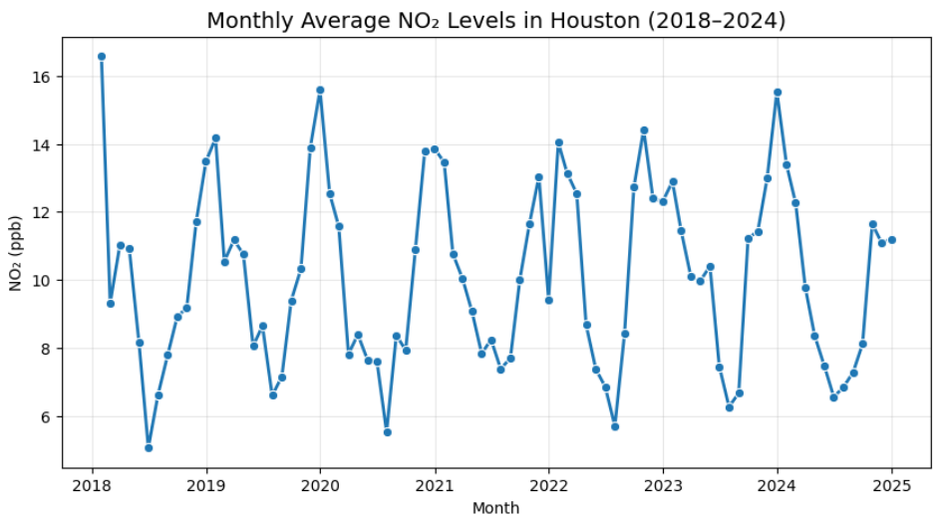
EDA Graphs

Slide 9
Feature engineering
Derived temporal features: Month, Year, Day of Week, Weekend Flag
Added lag features: NO₂ (1-day, 2-day, 7-day), rolling mean (7-day)
Integrated weather variables: Temperature, Wind, Precipitation.

Slide 10
Model implementation
Baseline models:
Linear Regression
Random Forest
XGBoost (untuned)
Metrics used: MAE, RMSE, R²

Slide 11
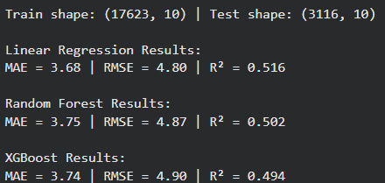
Results of the models before Hyperparameter tuning

Slide 12
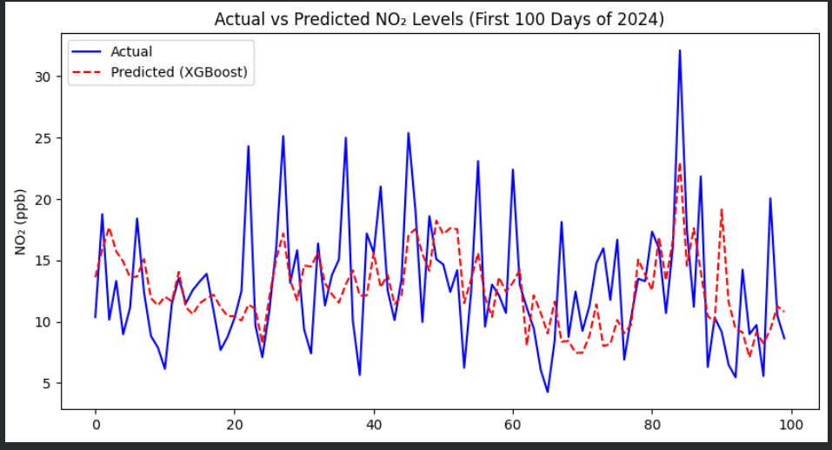

Slide 13
Hyperparamter tuning
Used GridSearchCV for parameter tuning
Evaluated parameters: learning rate, depth, n_estimators, subsample, etc.
R² improved from 0.494 → 0.524 after tuning

Slide 14
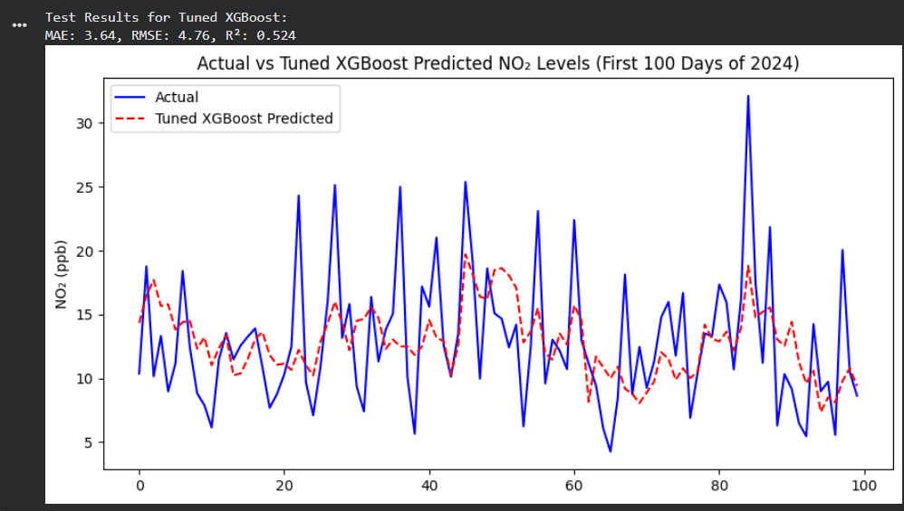

Slide 15
References
AlShehhi, A., Qamar, F., Khan, S., Hassan, N.U., Saeed, Q., AbuDagga, A., AlHebshi, R., AlAwadhi, A. & Taha, F., 2023. Artificial intelligence for improving Nitrogen Dioxide forecasting of Abu-Dhabi environment agency ground-based stations. Journal of Big Data, 10(1), pp.1-22.
  Link: https://journalofbigdata.springeropen.com/articles/10.1186/s40537-023-00754-z
Ahmad, N., Xu, X., Tang, Y., et al., 2024. ‘Estimation of ground-level NO₂ and its spatiotemporal variations using satellite data and nested XGBoost machine learning models’, Atmospheric Chemistry and Physics, 24, pp. 9645–9665.
  Link: https://acp.copernicus.org/articles/24/9645/2024/
Sulaimon, I.A., El-Shafie, A., Zaini, M.A. & Yafouz, B., 2021. ‘Air pollution prediction using machine learning – A review’, Sustainability, 13(11), 6349.
  Link:https://www.research.herts.ac.uk/ws/files/32433439/conference_paper_2_Ismail_etal.pdf

Slide 16
Next steps
Trying to Increase the accuracy of the model by including more temporal features like humidity, pressure from Open-Meteo API.
Trying to Implement ARIMA model.
Start doing the Full Project Report (FPR)

Slide 17

THANK YOU

